Slide 1
Modeling and Analyzing the Spatiotemporal Travel Patterns of Bike Sharing: A Case Study of Citi Bike in New York

Slide 2
Introduction
Urban Transportation Challenges:
Growing demand for transportation in cities.
Traffic congestion and pollution.
The need for efficient, sustainable transportation solutions.
Focus on Bike Sharing:
Bike-sharing systems as a flexible, eco-friendly transportation mode.
Citi Bike: A key bike-sharing system in New York City.
Research Objective:
Analyze the spatiotemporal patterns of bike-sharing trips in New York City (Citi Bike).
Focus on understanding community clustering and travel behaviors.

Slide 3
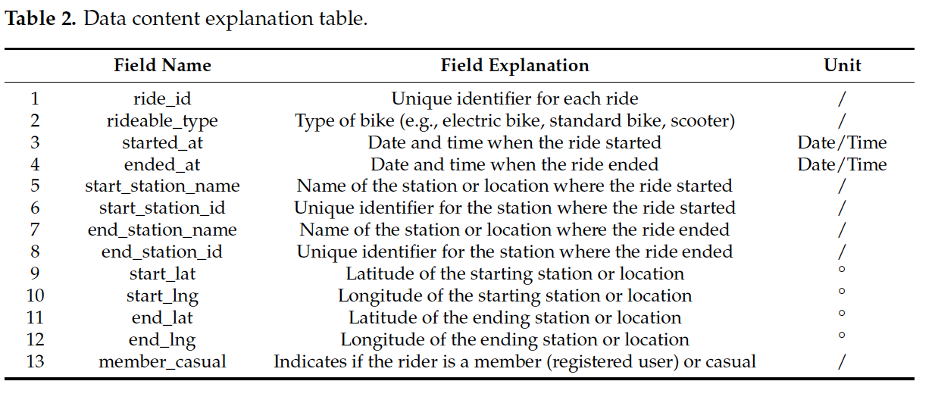
Research Data
Study Area: New York City (Citi Bike usage data for 2023)
Key Data:
GPS data from Citi Bike.
Zoning data from the NYC Open Data website.
Information on start/end stations, trip times, and duration.
Core Focus Area: Manhattan, the primary area for bike-sharing usage.
Methods Used
Kernel Density Estimation:
Used to calculate the density of bike-sharing origins and destinations.
Helps identify high and low usage areas.
Complex Network Theory:
Modeling bike-sharing stations as a network of nodes and edges.
Node Strength: Measures the importance of each station in the network.
Community Detection: Identifying clusters of stations with strong internal connectivity (using the Louvain algorithm).

Slide 4
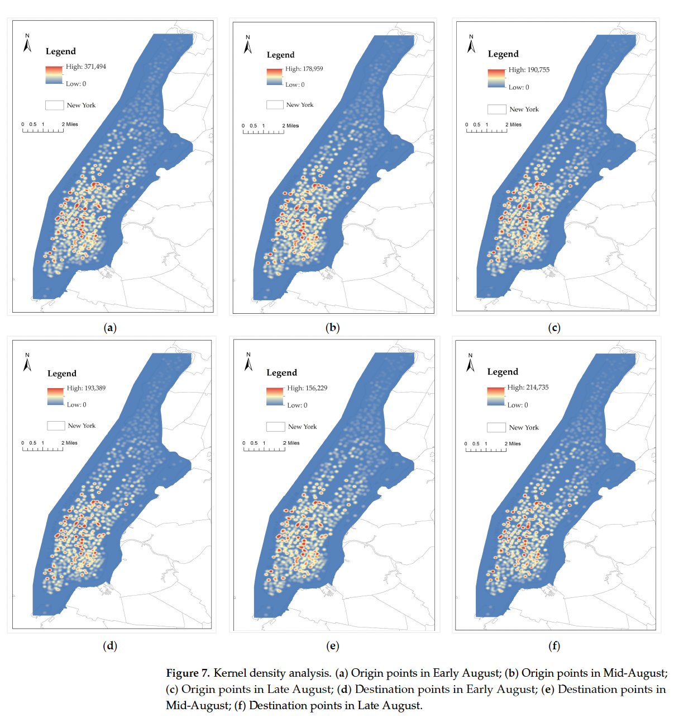
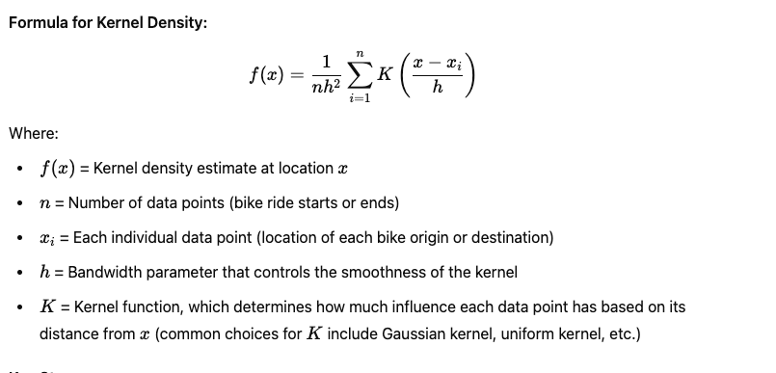
Kernel Density Estimation:
This is a statistical method used to estimate the density of spatial point data (in this case, the locations where bike rides start and end). It calculates the point density by considering each point (bike ride origin or destination) as a contributing factor within the influence range of a kernel function.
Key Points:
Kernel Function: A function that assigns weights to each data point. Common kernels include Gaussian and uniform kernels.
Bandwidth Parameter (h): This controls how far the kernel function spreads from the point. A larger bandwidth results in smoother estimates, while a smaller bandwidth gives more localized estimates.
Density Estimate (f(x)): This is the weighted sum of all points, with each point contributing to the density based on its proximity to a given location.
The kernel density method is helpful for visualizing areas with high or low bike-sharing usage, and the density hot spots typically show areas with high activity, such as tourist destinations, business centers, and transportation hubs.
Helps visualize where bike-sharing activity is concentrated

Slide 5
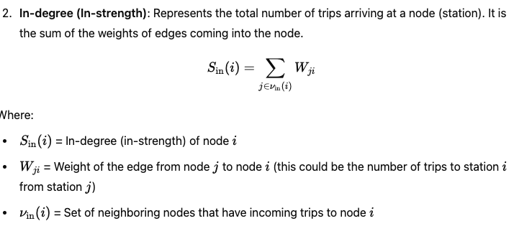
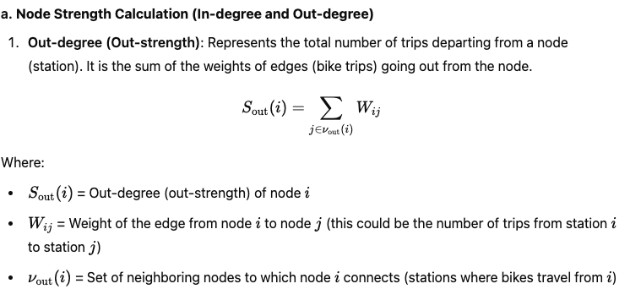
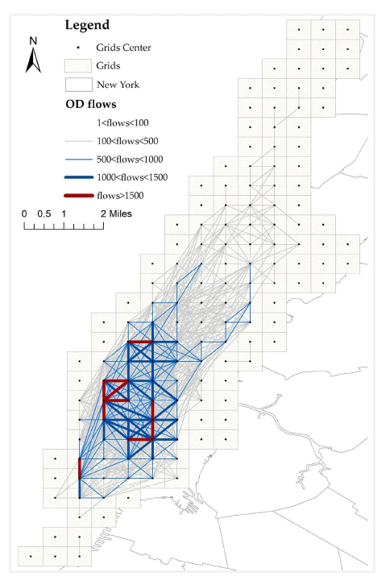
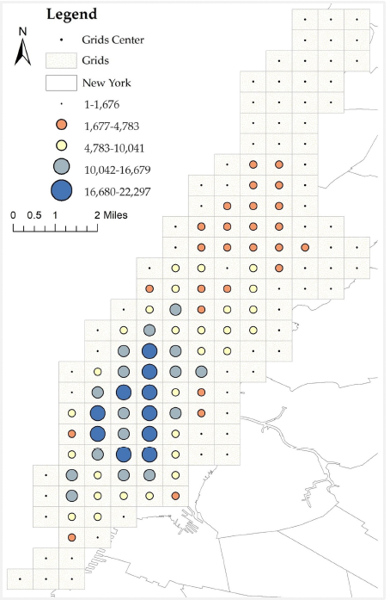
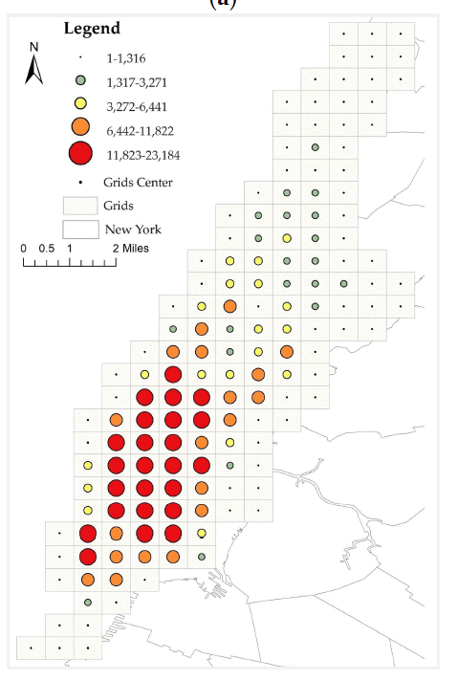
Complex Network Theory:
In the complex network method, we are analyzing the travel patterns by treating locations (stations) as nodes and bike trips as edges. The key calculations are related to node strength, degree centrality, and community detection.

Slide 6
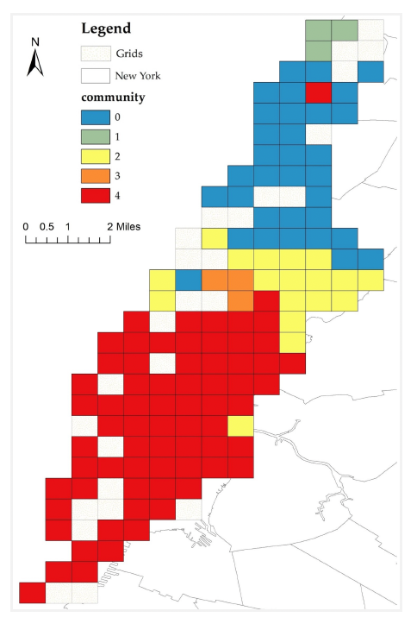
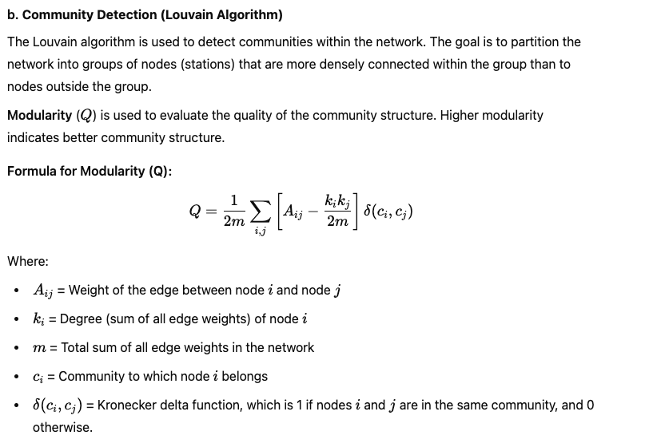

Slide 7
Key Findings
Seasonality:
Highest bike-sharing usage during summer months, especially August.
Peaks attributed to good weather and higher tourist activity.
High-Demand Areas:
Core Manhattan areas: Times Square, Financial District, Central Park.
High bike-sharing usage due to commercial activity and tourism.
Community Clusters:
Manhattan divided into several bike-sharing communities with distinct travel patterns.

